Slide 1
Mobile Health Sensor segmentation
Melvin Joshua

Slide 2
Project Abstract
This project delves into the analysis of mobile health data, encompassing sensor readings from various activities performed by multiple subjects, which is explored to uncover patterns and insights related to human movement and behaviour. PySpark, a powerful distributed computing framework, is employed for efficient data processing and manipulation. The project encompasses data cleaning, feature engineering, and clustering using the K-Means algorithm. Visualizations generated using matplotlib aid in understanding the distribution of activities, sensor readings, and their correlations. Outlier detection and imputation techniques are applied to ensure data quality. The findings of this analysis provide valuable insights into human activity recognition and can potentially contribute to the development of personalized health monitoring systems and applications.

Slide 3
Problem Statement
The increasing prevalence of mobile health devices has generated vast amounts of sensor data, presenting a challenge in effectively analysing and extracting meaningful insights related to human activity and behaviour.
Traditional data analysis methods may not be sufficient to handle the volume and complexity of this data.
There is a need for advanced techniques to automatically identify patterns, segment activities, and understand the relationships between sensor readings and human movement.

Slide 4
Objectives
To explore and visualize the distribution of different activities and sensor readings captured by mobile health devices.
To gain insights into the relationships between sensor readings and human activity, potentially leading to a better understanding of movement patterns and individual variations.

Slide 5
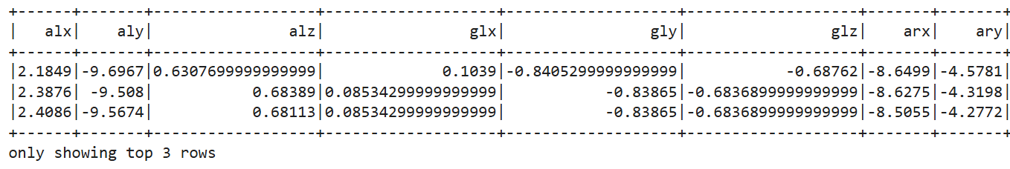
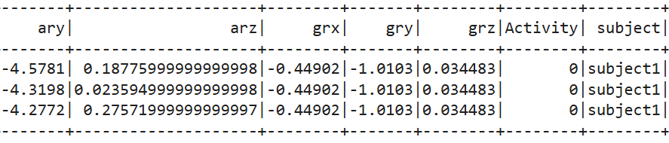
DataSET Description
There are 1215745 rows and 14 columns in this dataset. No null and no duplicate record found.

Slide 6
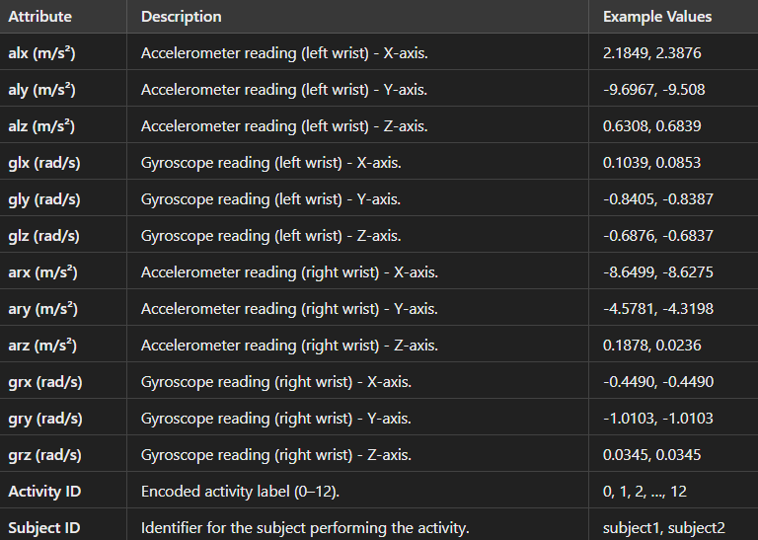
Attribute Information
DATASET SUMMARY
Activities: 12
Sensor devices: 3
Subjects: 10
ACTIVITY SET
The activity set is listed in the following:
L1: Standing still (1 min)
L2: Sitting and relaxing (1 min)
L3: Lying down (1 min)
L4: Walking (1 min)
L5: Climbing stairs (1 min)
L6: Waist bends forward (20x)
L7: Frontal elevation of arms (20x)
L8: Knees bending (crouching) (20x)
L9: Cycling (1 min)
L10: Jogging (1 min)
L11: Running (1 min)
L12: Jump front & back (20x)

Slide 7
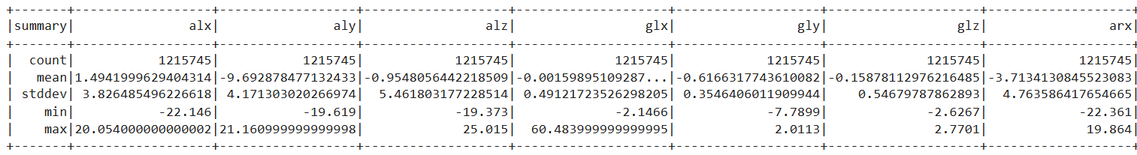
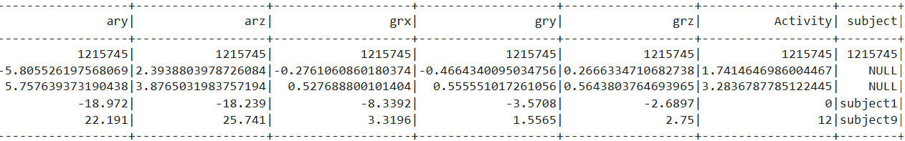
Descriptive Statistics

Slide 8
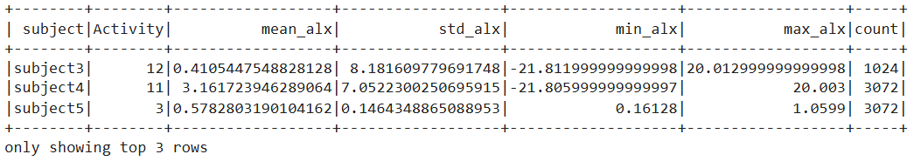
Descriptive Statistics
Summary Statistics after grouping the data by Subject and Activity

Slide 9
Feature Engineering
To improve the model performance and reduce bias: Feature Scaling (Min-max Scaling) - Transforms features to in the range [0, 1], ensuring equal treatment for all features by the model. Feature Assembling (Vectorization) - Combines multiple sensor readings into a single feature vector.

Slide 10
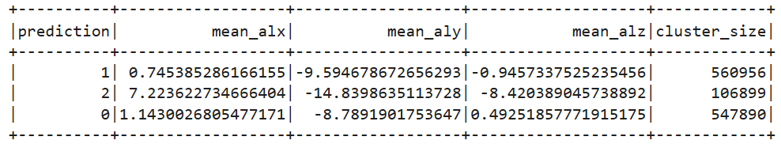
Clustering Model

Slide 11
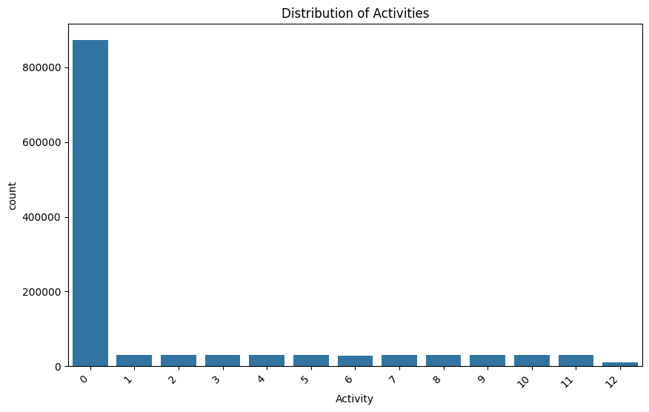
Visualization
The PySpark DataFrame has been converted to a Pandas DataFrame to do visualization because PySpark is generally a big data processing tool.
Majority of the activity lies in being idle without any shred of movement.

Slide 12
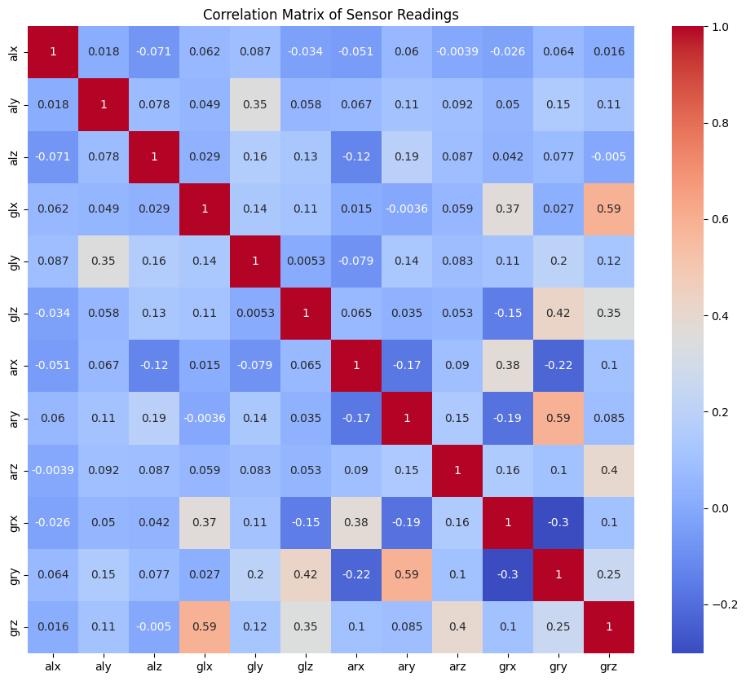
Correlation Analysis

Slide 13
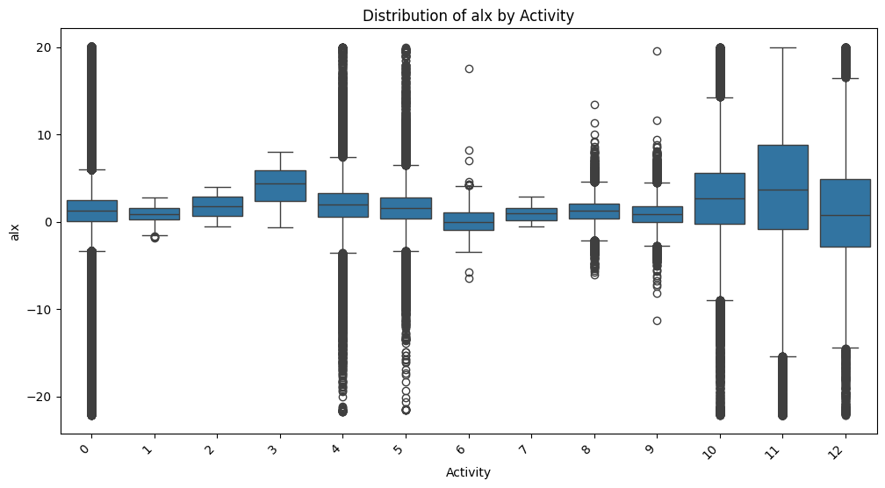
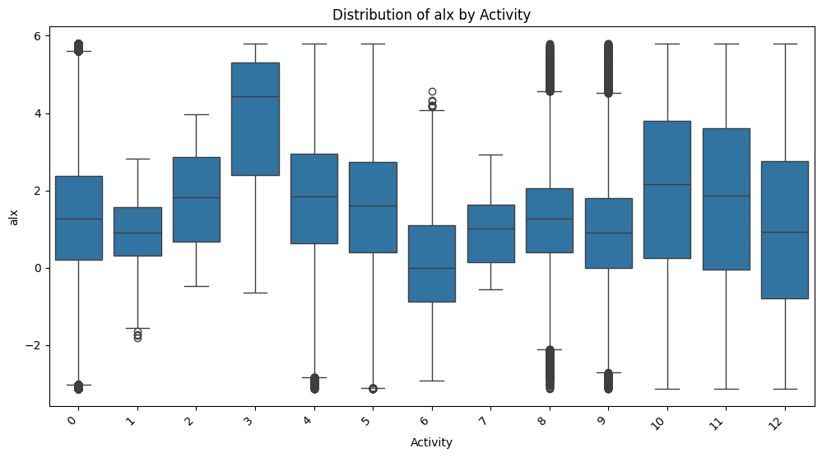
Handling Outliers
Before Handling Outliers
After Handling Outliers
Outliers are identified based on the IQR method, which get replaced with missing values, and then filled using linear interpolation to maintain data continuity. This approach helps to mitigate the impact of outliers on subsequent analysis.

Slide 14
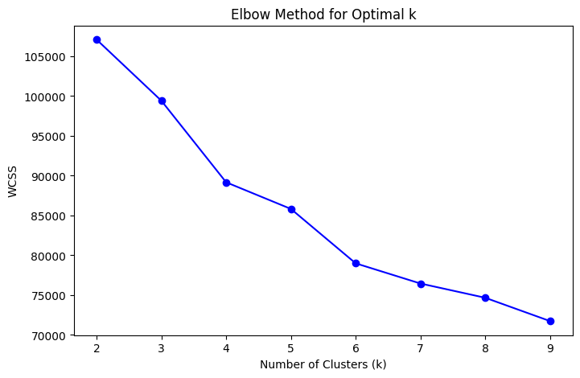
Elbow Method
The optimal number of clusters as per the figure is 5.
Silhouette Score turned out to be 0.28, which may seem weak but it is the maximum it could get provided the Activity label does not influence the clustering.

Slide 15
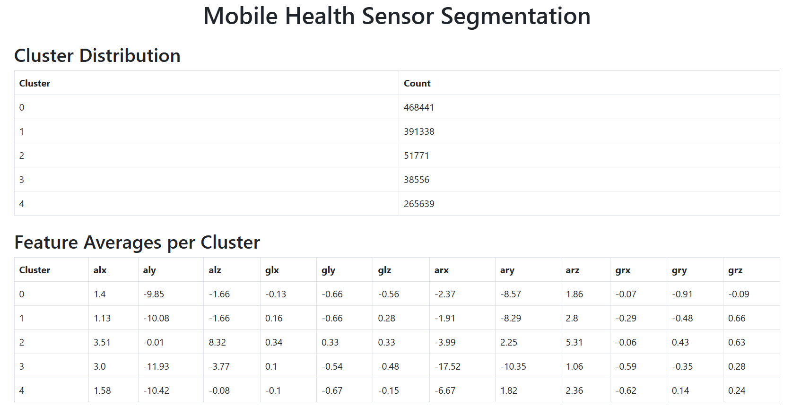
Model Deployment

